Slide 1
Gene Expression in Patients with Amyotrophic Lateral Sclerosis (ALS)
Zequan Wang, MSN, RN & Tingting Zhao, MSN, BSN, RN
Group 2

Slide 2


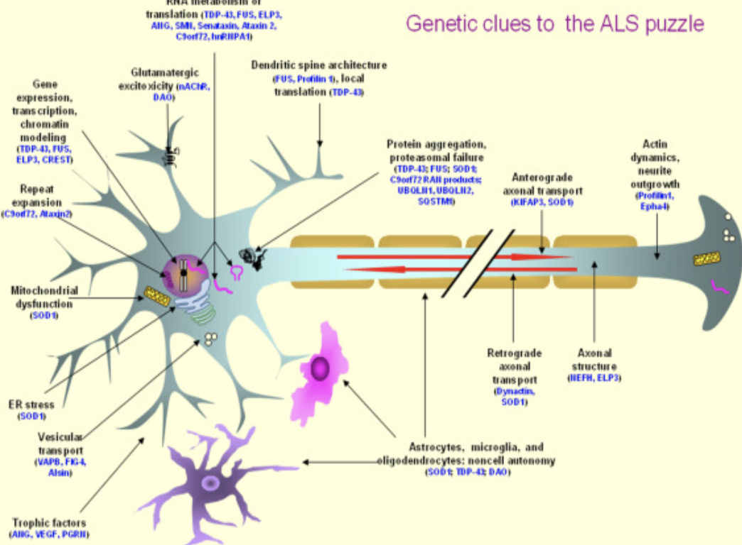

Slide 3
Study Purpose
By assessing and comparing the gene expression level between ALS and control group, we can understand the potential pathological mechanism in ALS.
Evidence has shown that the OXTR (oxytocin receptor) is a risk gene related to the etiology of neuropathy. (Quintana et al., 2019)
OXTR also frequently implicated in human social behavior and it associated with psychiatric disorder phenotypes (Thaler et al., 2020)

Slide 4
Sample
Subjects:
Original design contains 7 ALS and 8 healthy control samples. We take 2 from each of the groups as those 4 samples are less likely affected by the confounding variables.
Procedures:
Postmortem cervical spinal section was used to extract total RNA.
•Individual Illumina Total Stranded RNA-sequencing libraries for each sample
•Each library was sequenced with >50 million 2X150 sequencing reads on the NextSeq500.
Paired end reads

Slide 5
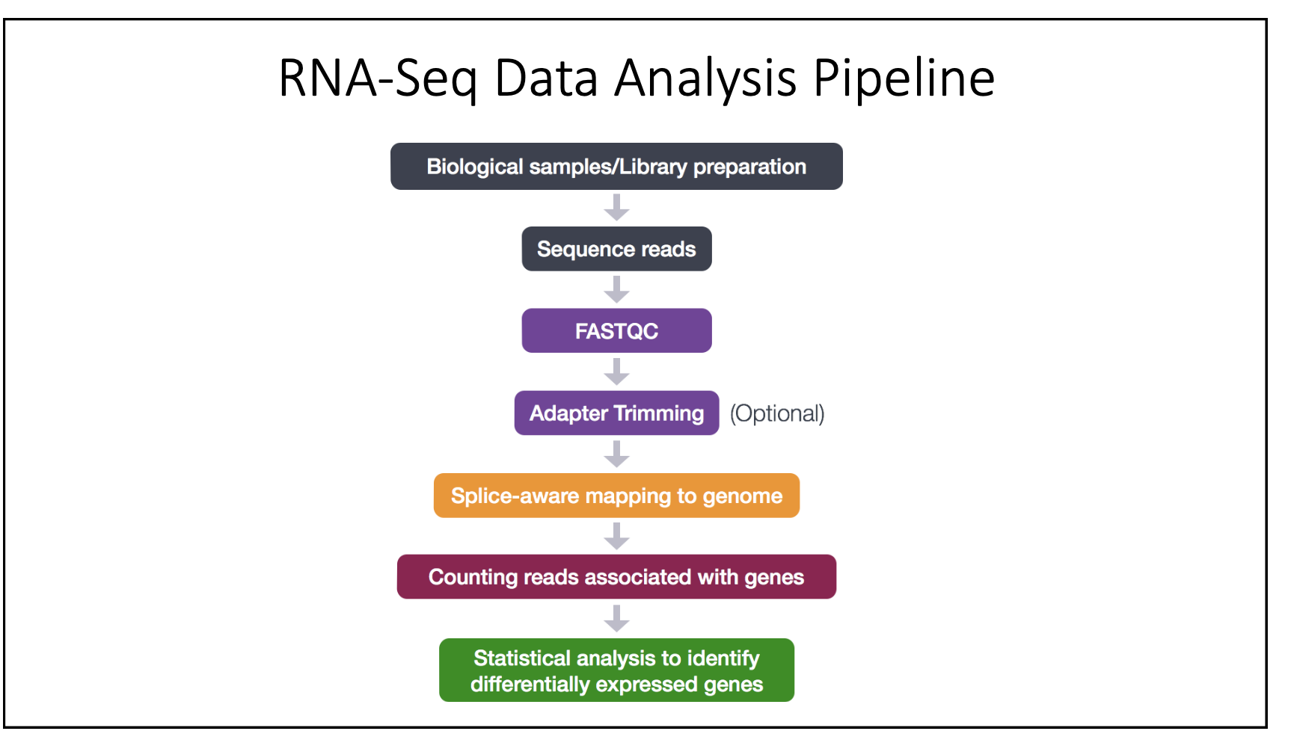
Flow chart of RNAseq analysis

Slide 6
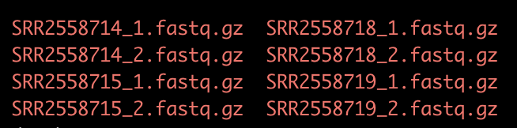
Accessing the data using SRA-Toolkit
We downloaded data from the NCBI. The SRA accessions are as follow:
ALS group: SRR2558714 & SRR2558715
Healthy control: SRR2558718 & SRR2558719
We download fastq files using sratoolkit 2.8.2.
We used the split_files, dump each read into separate files as our reads are paired-end.
Notes:
Split-files: separates the read into left and right ends, and puts the forward and reverse reads in two separate files. This creates two files.

Slide 7
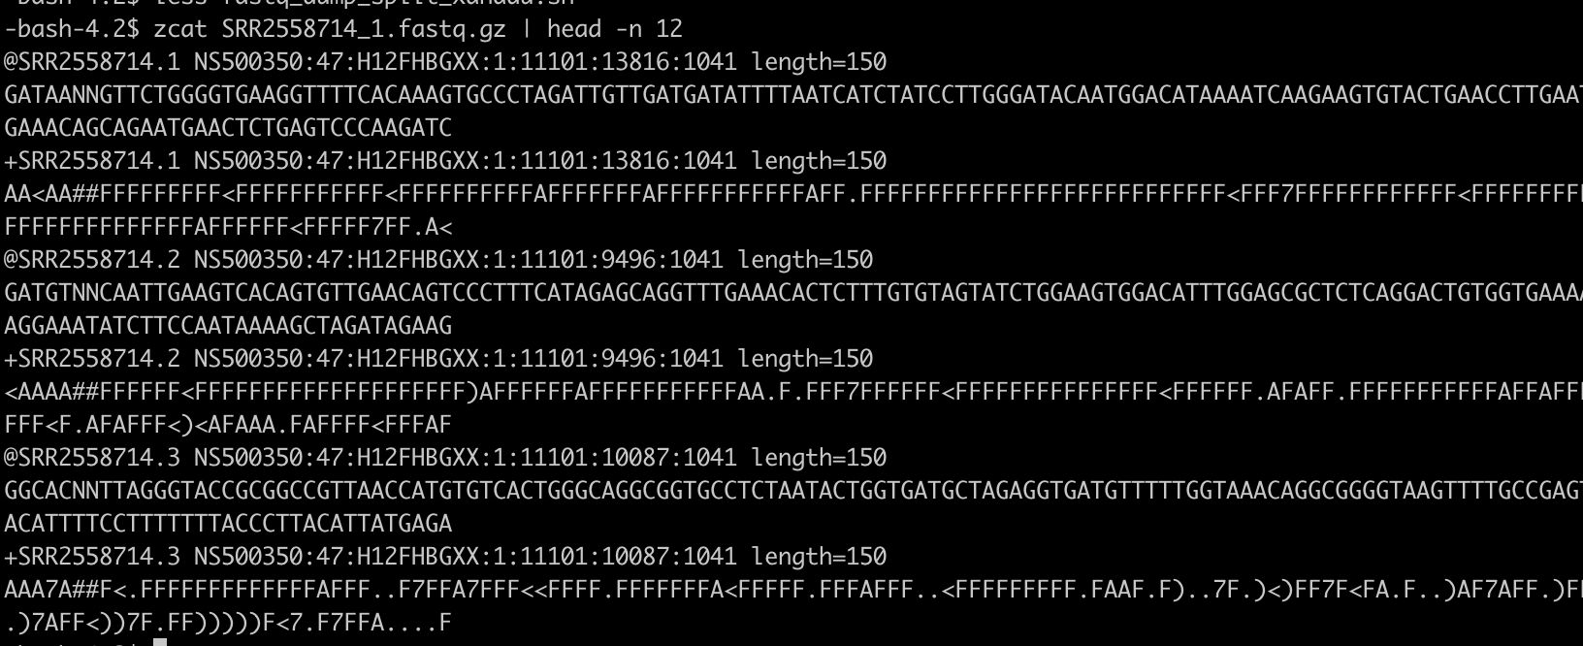
Accessing the data using SRA-Toolkit
The sequence files are in fastq format and compressed using gzip. We have a look at the contents of one of the fastq files:

Slide 9
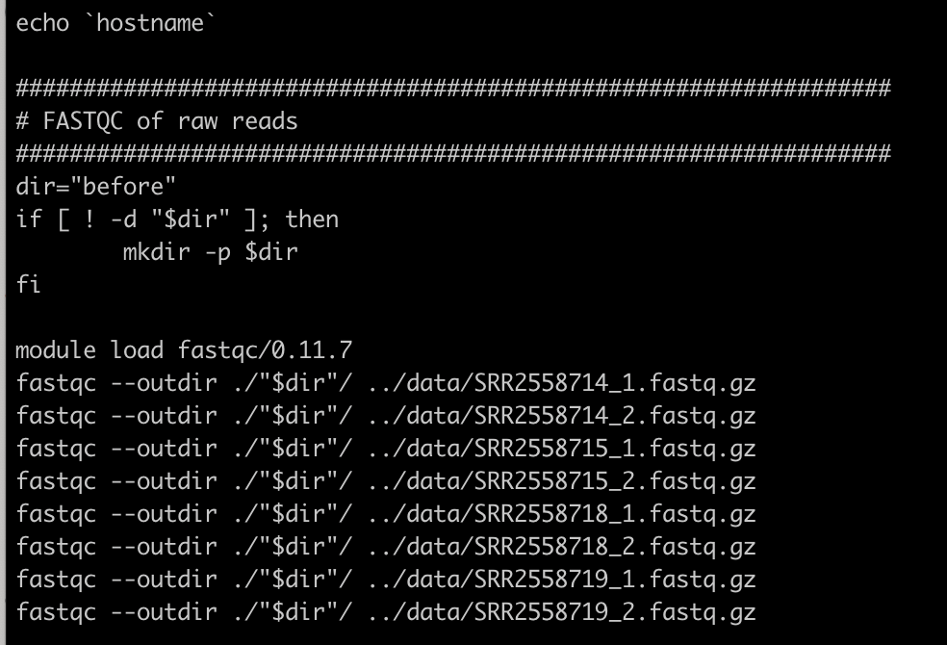
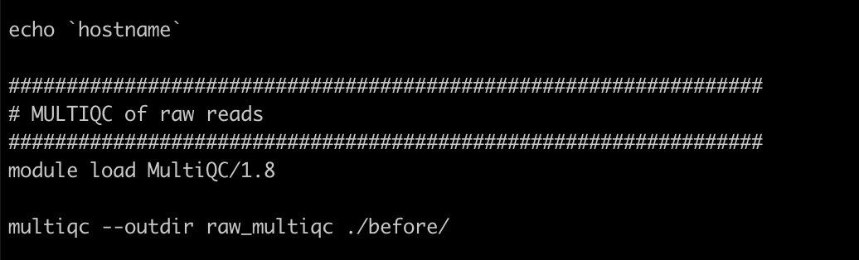
FASTQC
This step we perform a FASTQC which is helpful to see how the quality of the data has changed before and after trimming using Trimmomatic. To do this, we used the command-line of fastqc.
The fastq module load was version of 0.11.7

Slide 10
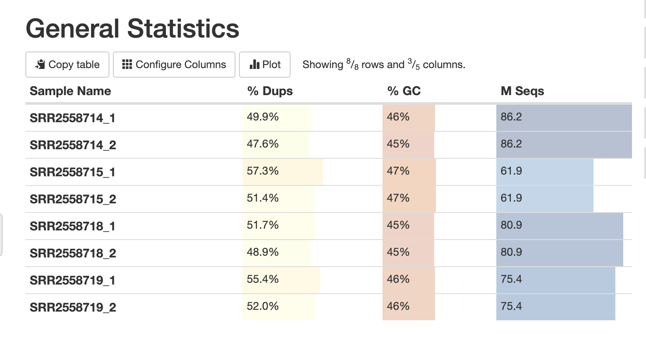
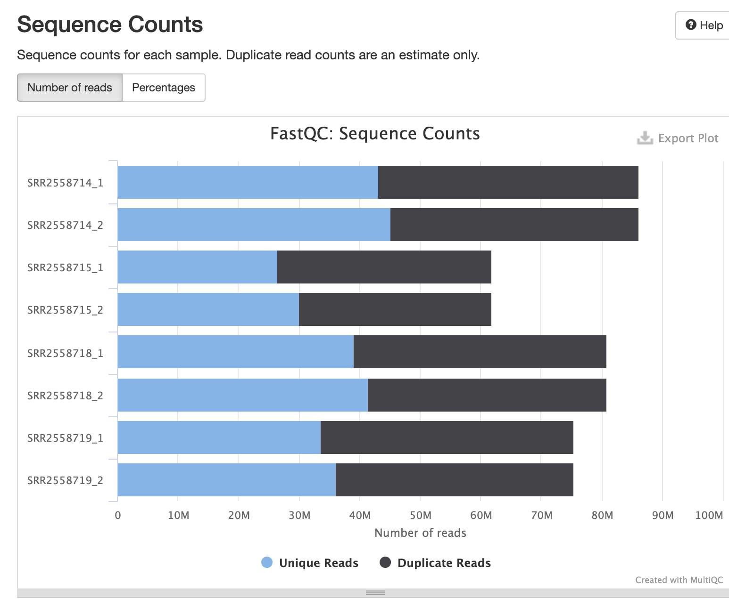
MultiQC results

Slide 11
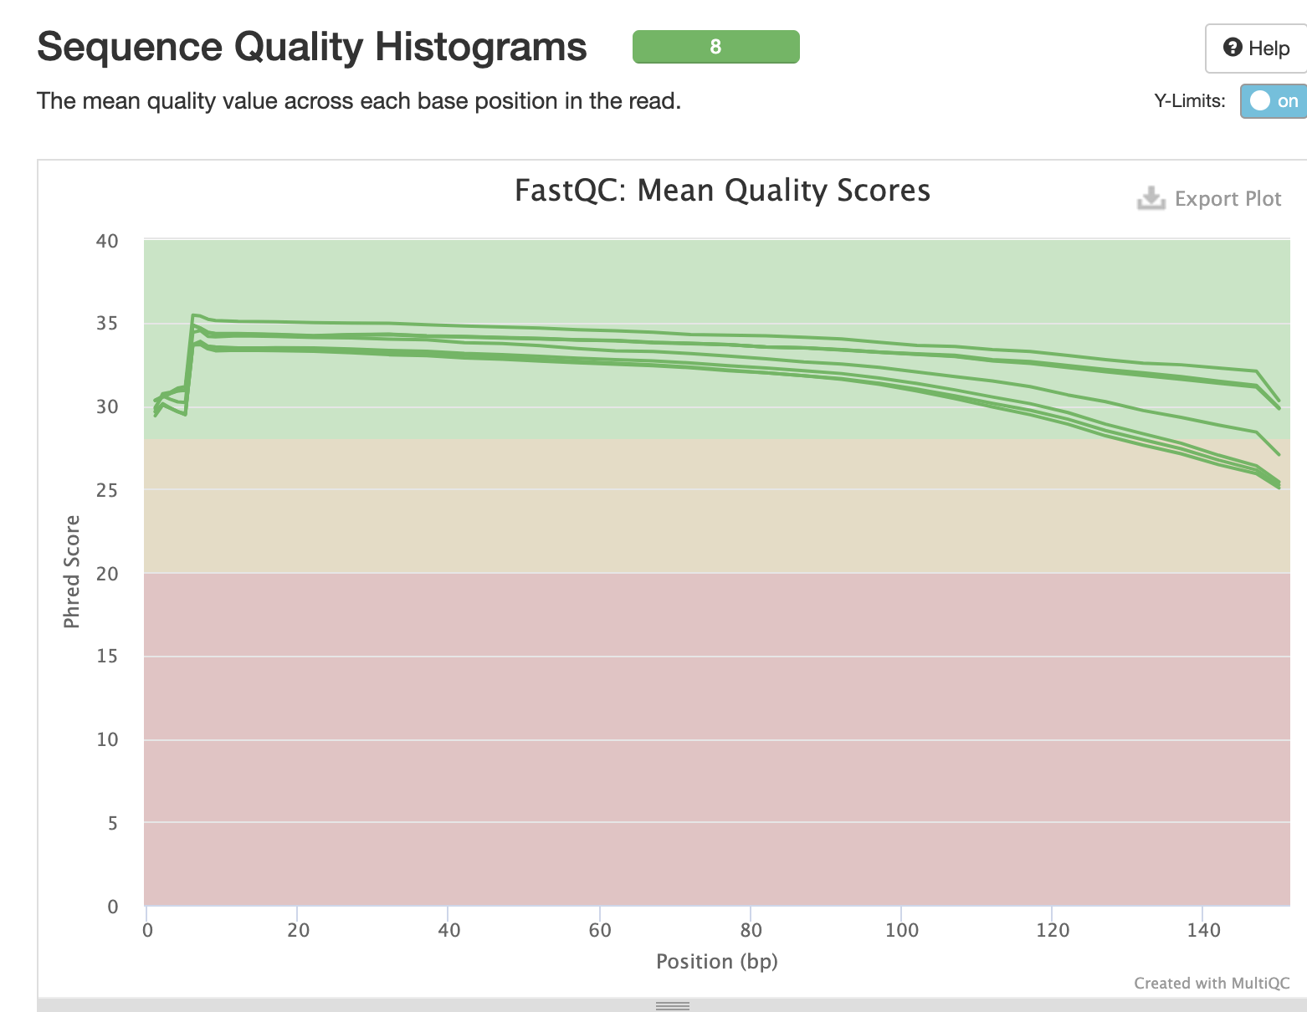
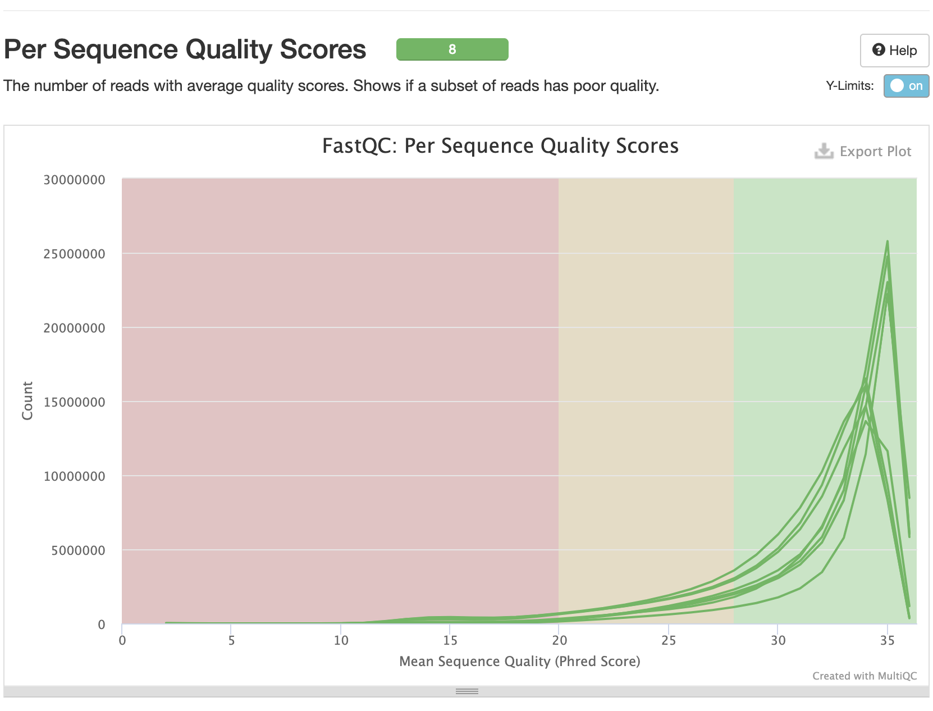
MultiQC results

Slide 12
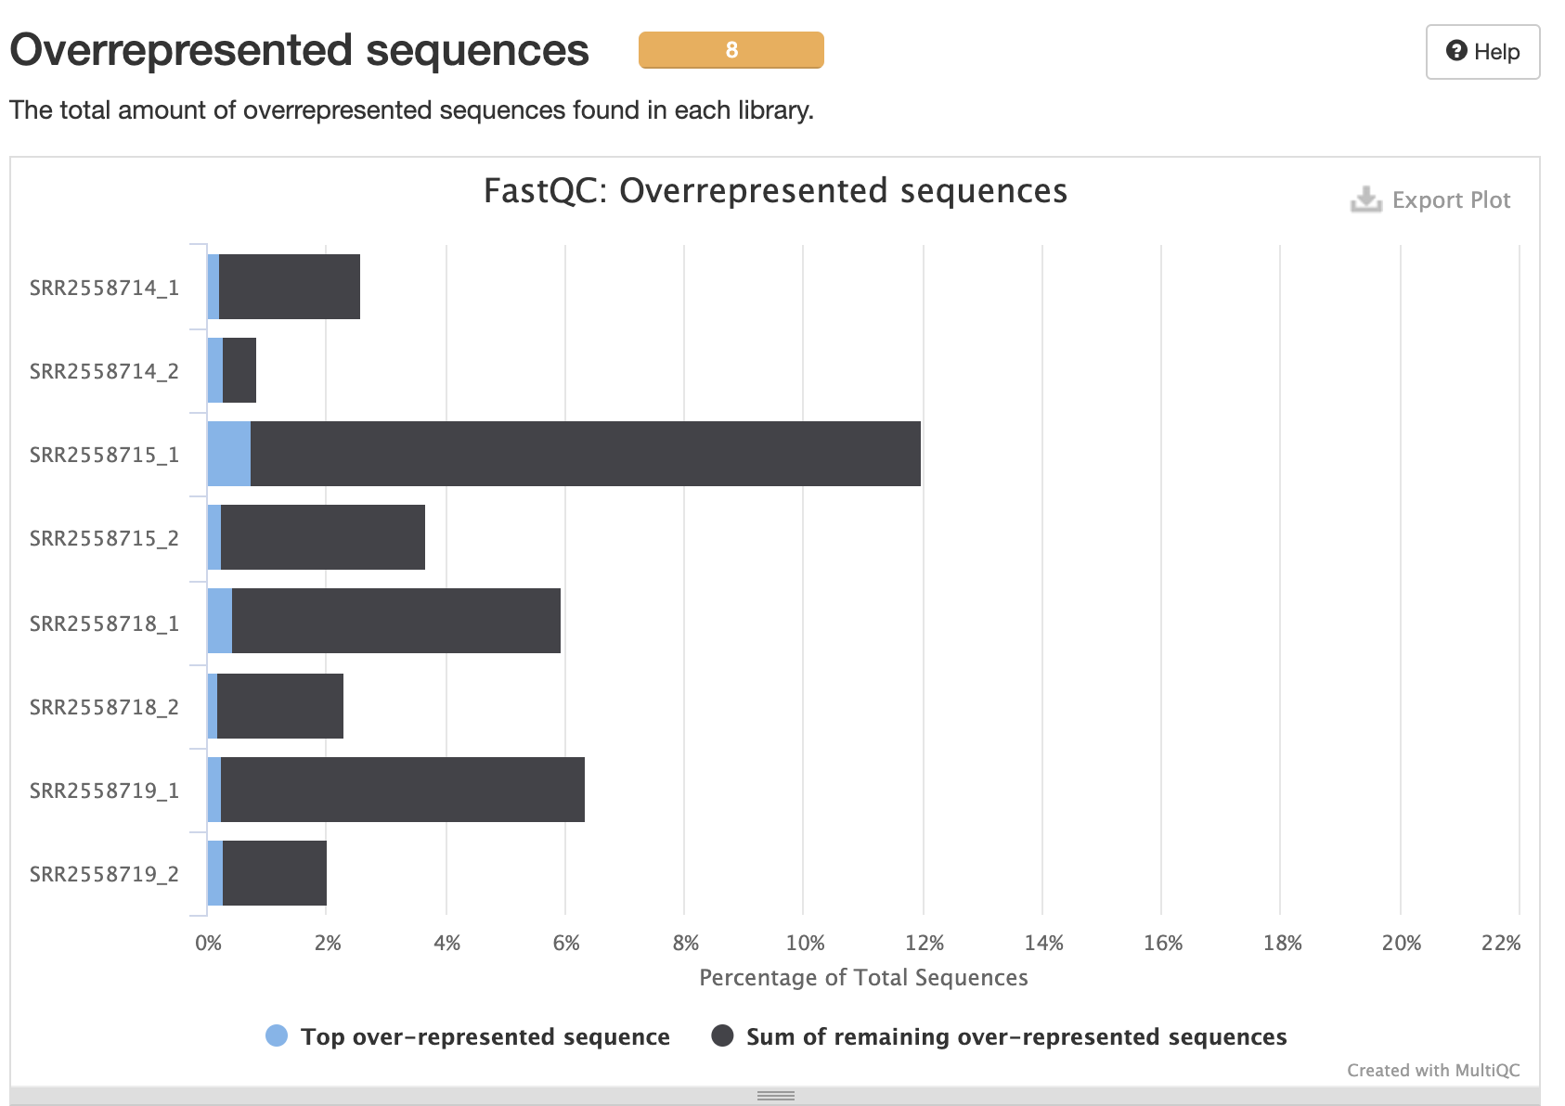
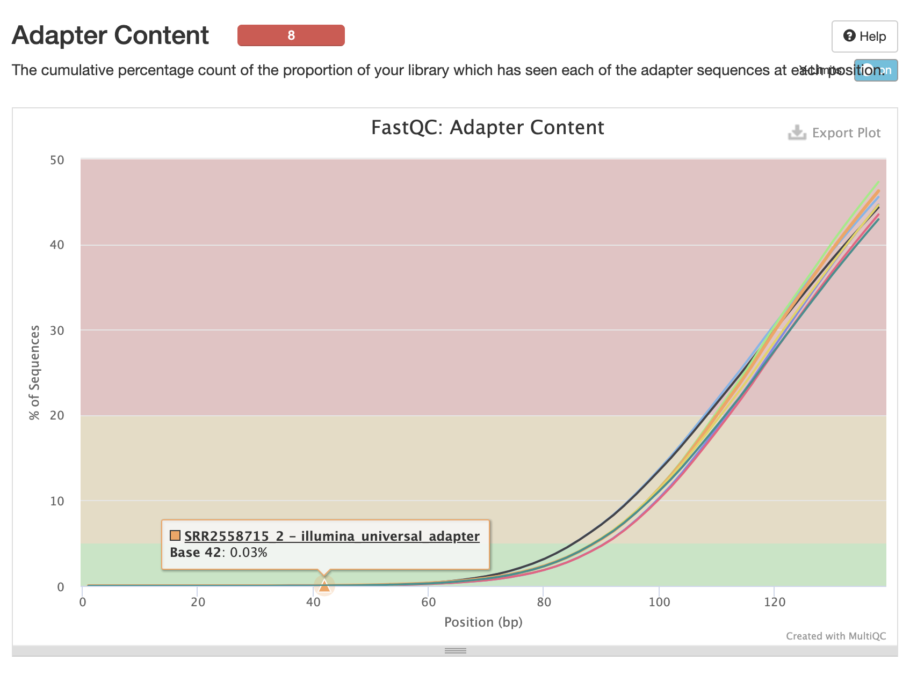
MultiQC results

Slide 13
Quality Control Using Trimmomatic
We used Trimmomatic trim low-quality reads and adapter.
As our data is paired-end reads, we kept our fastq.gz separated in this procedure (SRR_1trim.fastq.gz & SRR_1un_trim.fastq.gz).
Instead of SE for single-end made, we used PE for paried-end mode based on the Trimmomatic manual.
ILLUMINACLIP: Truseq3-PE. Command searched for adapter sequence.
Slidingwindow: we used 4:15 scaned through the read, cutting the read when the average base quality in a 4 window frops below 15 which is matched with our quality scores.
Notes:
Keep both reads can be useful when working with paried-end data. It may keep even redunfant information but this likely makes our pipelines more manageable.

Slide 14
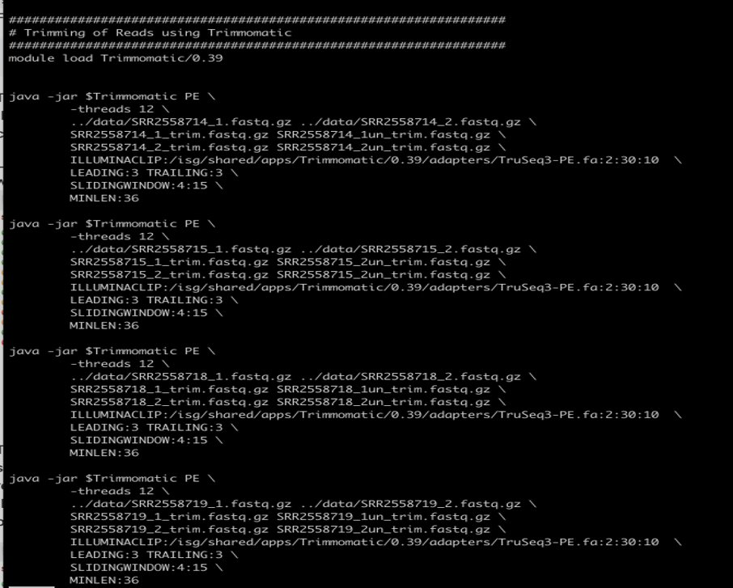

Slide 15
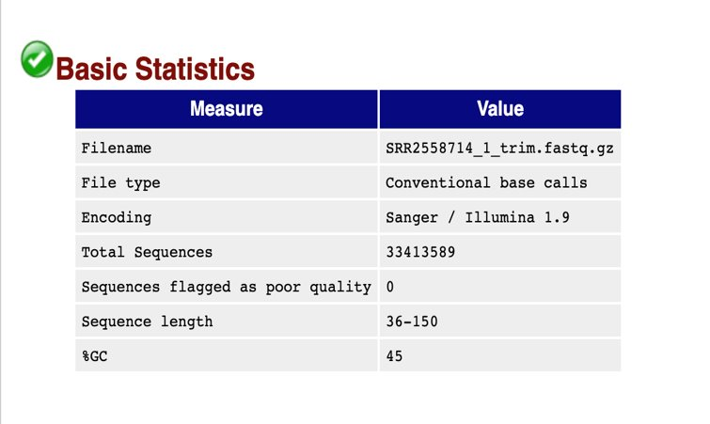
FASTQ before and after quality control
We used Cyberduck to view the ftml files. ​
FASTQ Report: take SRR2558714_1 as example:​

Slide 16
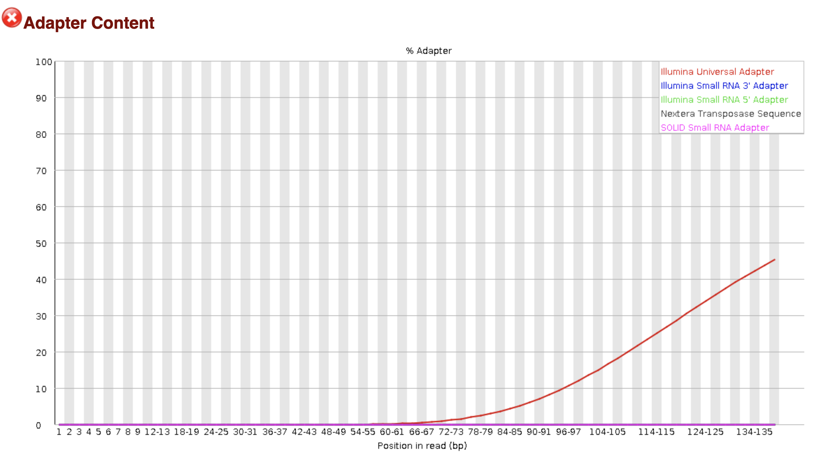
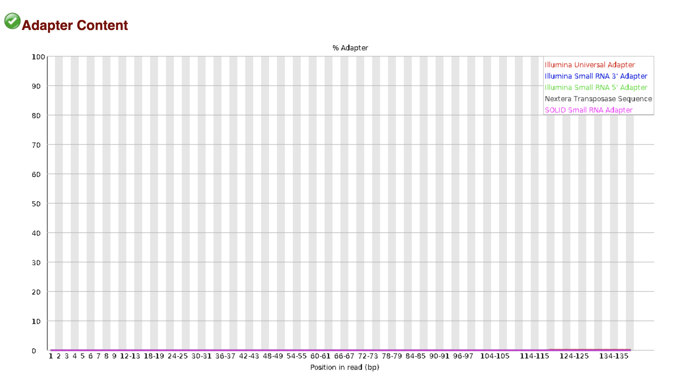
FASTQ before and after quality control

Slide 18
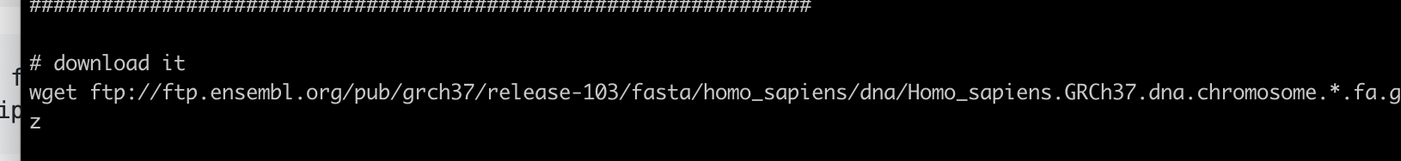
Aligning reads to a genome using HISAT2
We used HISAT2 mapping our data against the hg19 human genome
We used wget command download the hg19 from ENSEMBL database.

Slide 19
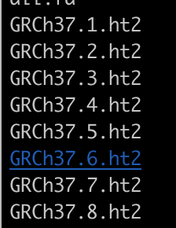
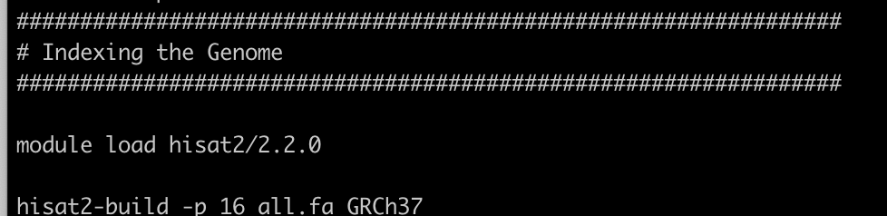
Aligning reads to a genome using HISAT2
Next, we created a genome index which is ordered in an easily navigable way with pointers to the information we seek within.
We used the hisat2-build module making a HISAT index file for the genome
Notes:
After running the scrpt, the following files will be generated as part of the index.

Slide 20
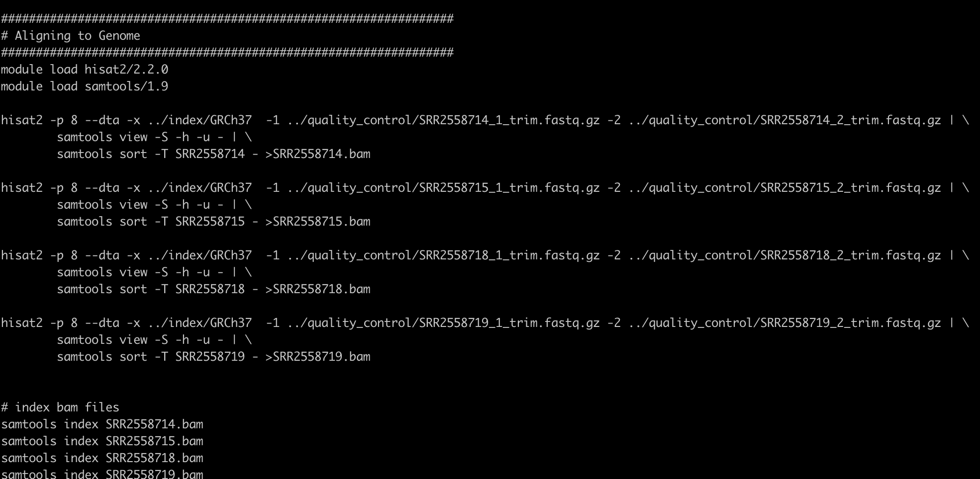
Aligning reads to a genome using HISAT2
We used pipe to send the results from HISAT2 to samtools to sort the sequences, convert them to binary format and compress them. The resulting files were in BAM format.

Slide 21
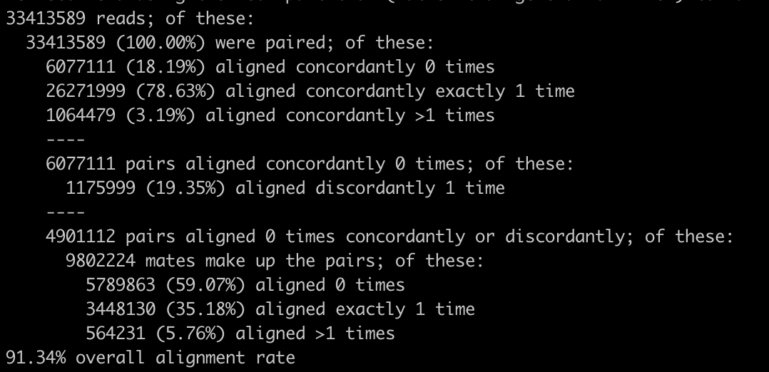
Aligning reads to a genome using HISAT2
An alignment summary for one single sample is shown below:
91.34% overall alignment rate

Slide 22
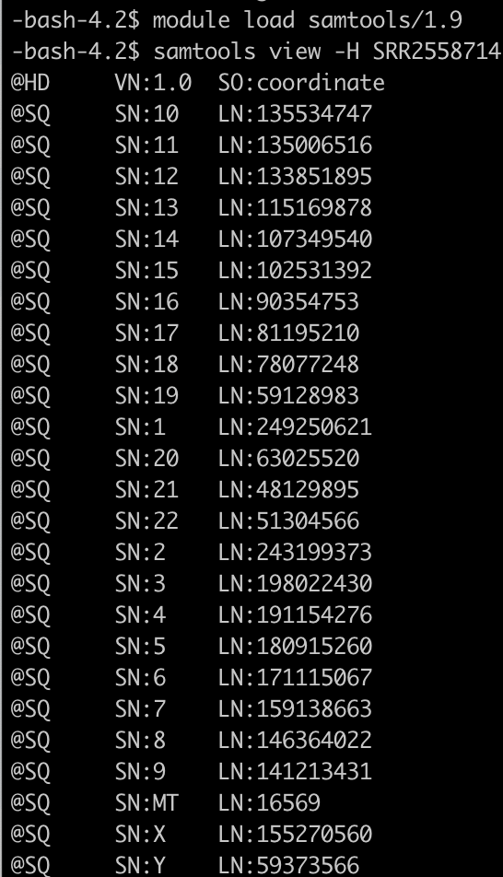
Aligning reads to a genome using HISAT2
Then we looked at the BAM files by sametools view –H SRR2558714.bam | head

Slide 23
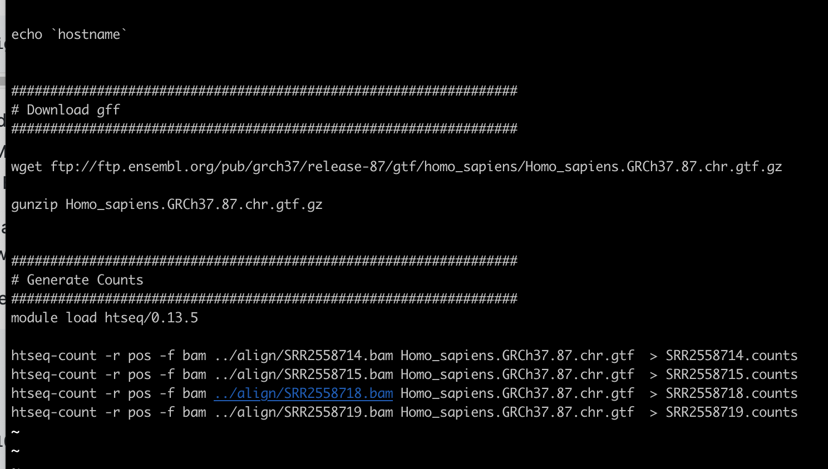
Generating total read counts
We used the program htseq-count to count how many reads map to each annotated gene in the genome. To do this, we first downloaded the annotation file which is in GFF format.

Slide 24
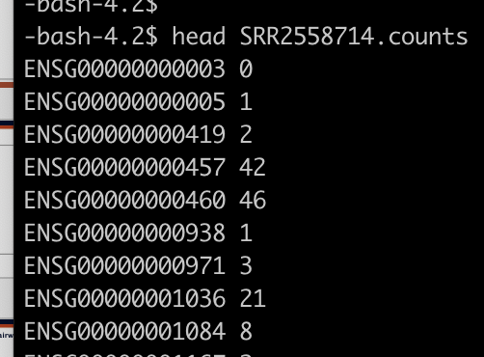
Generating total read counts
Layout is quite straightforward, with two columns separated by a tab. The first column gives the Ensembl gene ID, the second column is the number of mRNA fragments that mapped to the gene. These counts are the raw material for the differential expression analysis in the next section.

Slide 26
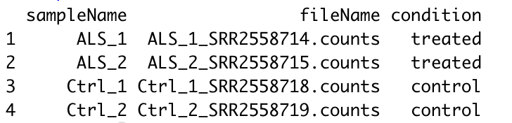
Pairwise Differential Expression with Counts in R
This step, we used R package DESeq2 to identify differentially expressed (DE) genes.
We used Cyberduck and downloaded the counts from xanadu.
Sample table:

Slide 27
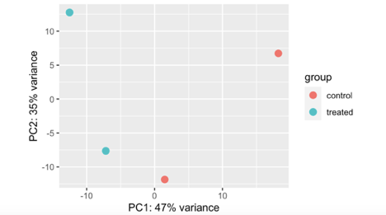
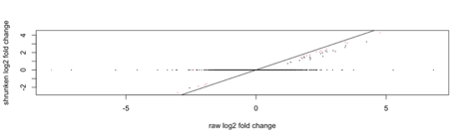
Normalized, variance-stabilized transformed counts for visualization

Slide 28
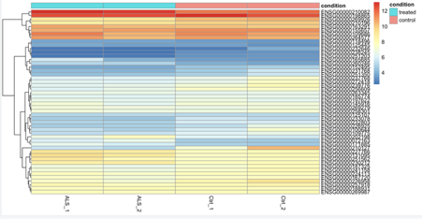
Top 50 log fold change genes-heatmap

Slide 29
Reference
Quintana, D. S., Rokicki, J., van der Meer, D., Alnæs, D., Kaufmann, T., Córdova-Palomera, A., Dieset, I., Andreassen, O. A., & Westlye, L. T. (2019). Oxytocin pathway gene networks in the human brain. Nature communications, 10(1), 668.
Thaler, L., Brassard, S., Booij, L., Kahan, E., McGregor, K., Labbe, A., Israel, M., & Steiger, H. (2020). Methylation of the OXTR gene in women with anorexia nervosa: Relationship to social behavior. European eating disorders review : the journal of the Eating Disorders Association, 28(1), 79–86.

